Slide 1





SCHOLARSHOME SCHOOL MANAGEMENT SYSTEM [Teacher’s Module]
Presenters
Atef Ahmed Chy
Ahmed Thousif
Vivek Anand Singha
Shahir Ahmed Chy

Slide 2
SCHOLARSHOME SCHOOL MANAGEMENT SYSTEM [Teacher’s Module]
Presenters
Atef Ahmed Chy
Ahmed Thousif
Vivek Anand Singha
Shahir Ahmed Chy
Scholarshome School Management System [Teacher’s Module], also known as S.S.M.S, is a system made for multiple useful usages for the school. It helps the school administration to keep tabs of schedules of the school teacher and also has an administrative system within the interface with perks such as being able to monitor and modify tasks and schedules that are already set for the teachers within the given schedule as well as monitor classes via CCTV footages.

Slide 3
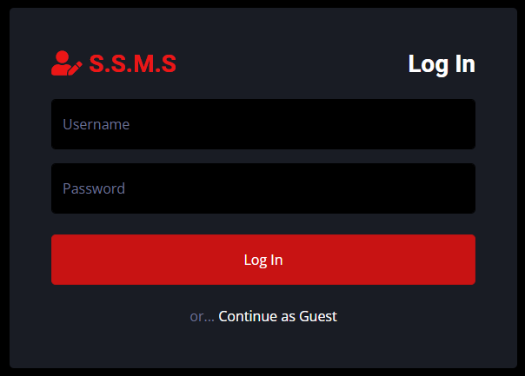
SCHOLARSHOME SCHOOL MANAGEMENT SYSTEM
Presented to you by XXXXXXXXXXXXXXX
Scholarshome School Management System [Teacher’s Module], also known as S.S.M.S, is a system made for multiple useful usages for the school. It helps the school administration to keep tabs of schedules of the school teacher and also has an administrative system within the interface with perks such as being able to monitor and modify tasks and schedules that are already set for the teachers within the given schedule as well as monitor classes via CCTV footages.
S.S.M.S has two interfaces, both of which you can enter from this log-in page.

Slide 4
S.S.M.S has two interfaces, both of which you can enter from this log-in page.

Slide 5
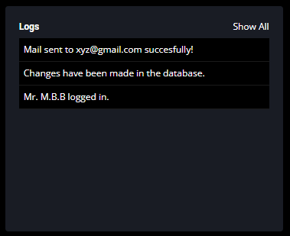
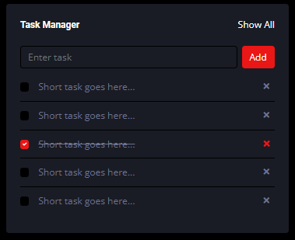
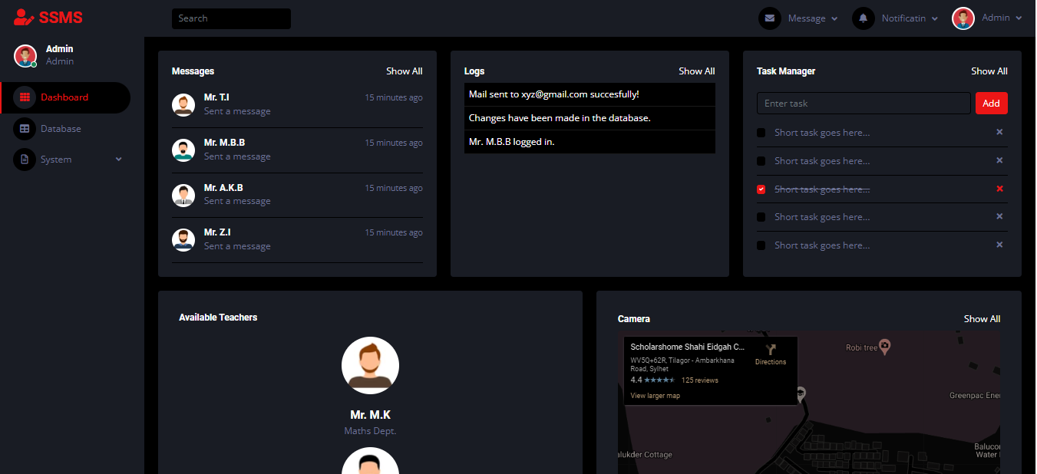
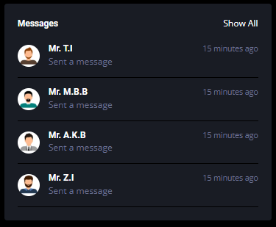
This is the administrator interface.

Slide 6
This is the administrator interface.

Slide 8
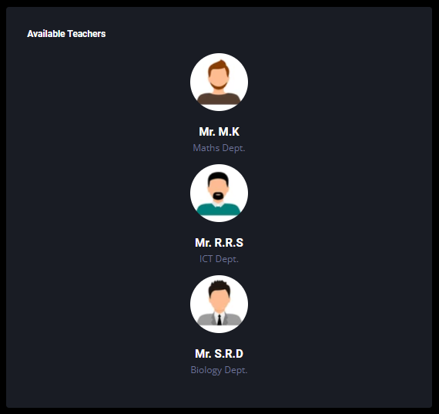
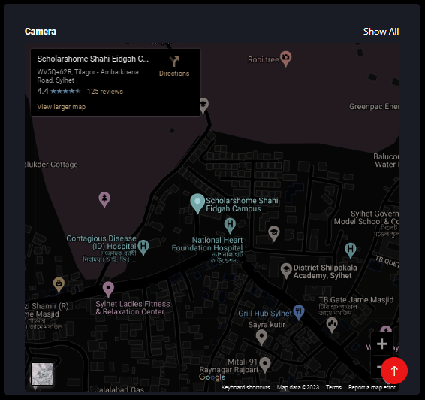

Slide 9


Slide 11
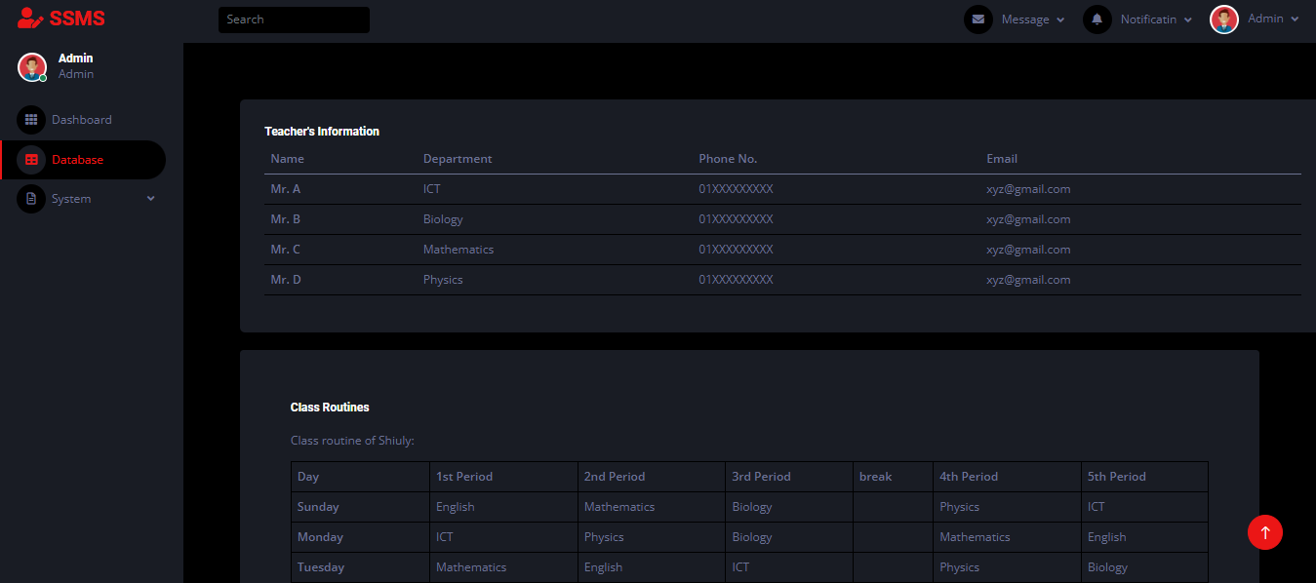
Database has all the information about all the teachers and routines of all the classes

Slide 12
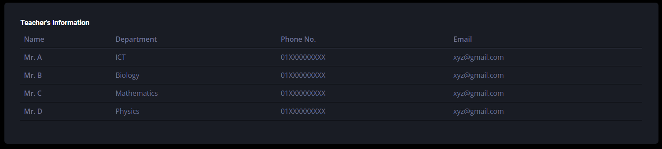
Information about the teachers will be available in the system.

Slide 13
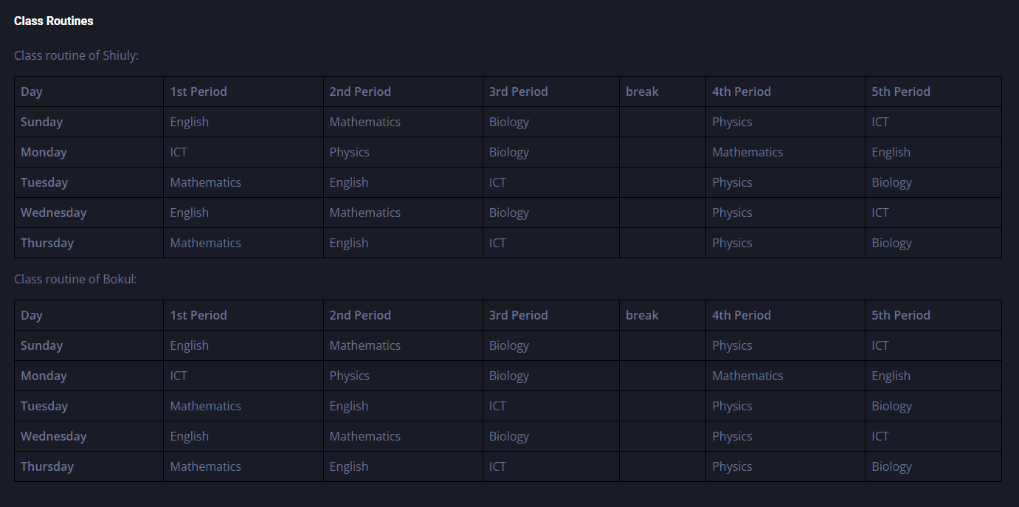
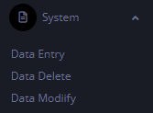
Routines of all classes will be available in this system

Slide 14
Data Entry: It will store data in the database.
Data Delete: Will delete stored data in the database.
Data Modify: It will change the stored data in the database.
S.S.M.S has two interfaces, both of which you can enter from this log-in page.

Slide 15
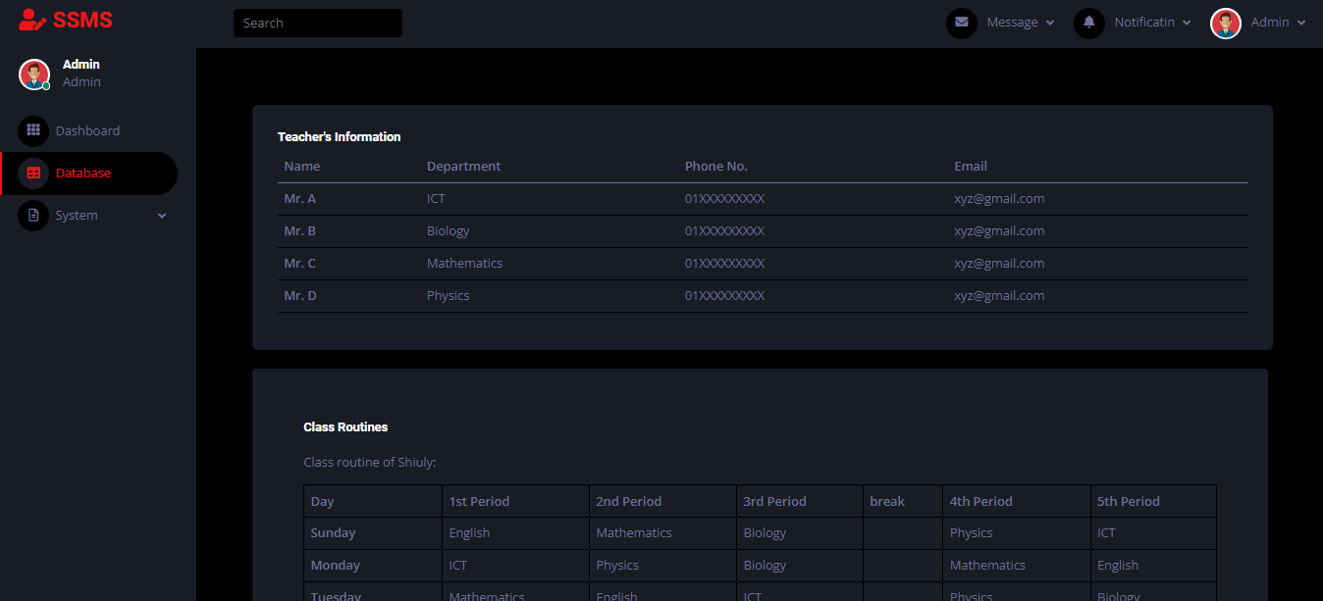
S.S.M.S has two interfaces, both of which you can enter from this log-in page.

Slide 16
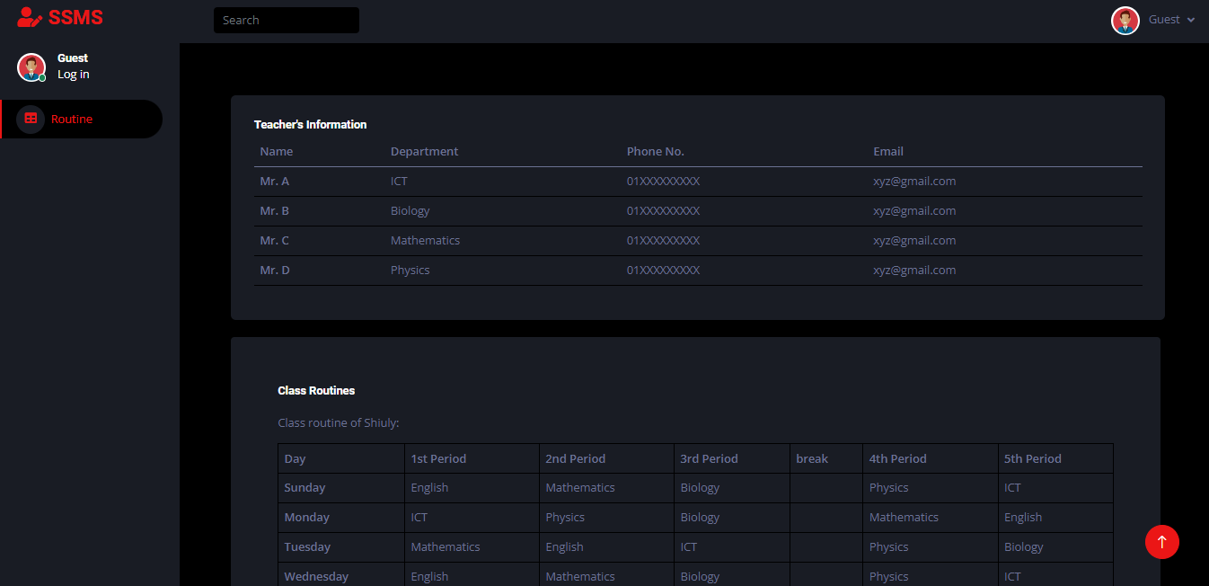
S.S.M.S has two interfaces, both of which you can enter from this log-in page.
THANK YOU
For your time

Slide 17
THANK YOU
For your time

